Slide 1
Knowledge Management in Action: Example From Indonesia
Notes:
This presentation will outline the Knowledge Management (KM) Road Map to address knowledge management needs, and present an example using the Improving Contraceptive Method Mix project in Indonesia.
There are many different definitions of KM, but all share common themes. We define KM as a systematic process of collecting knowledge and connecting people to it so they can act effectively and efficiently.

Slide 2
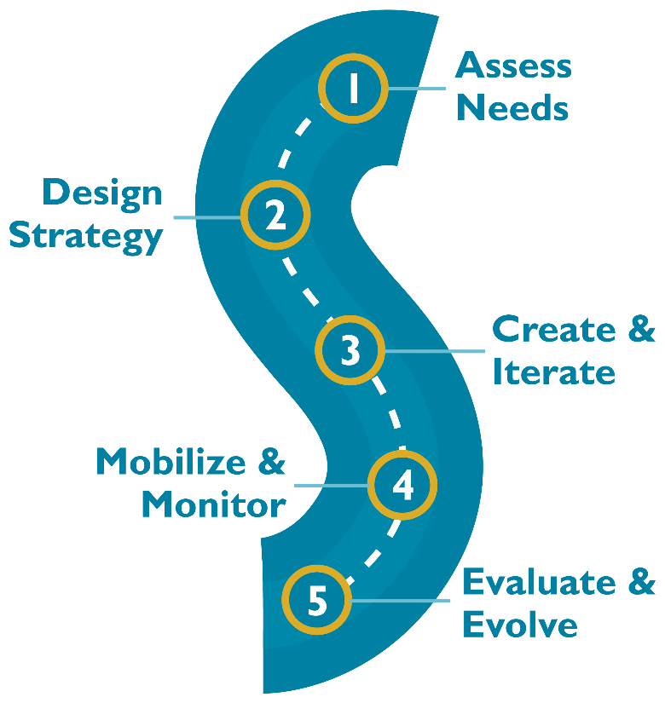
HOW to do KM? The KM Road Map: A Systematic Process
Notes:
How do we go about doing KM? The K4Health Project has outlined a five-step process for applying KM to global health programs. The five-step process is called the KM Road Map.

Slide 3
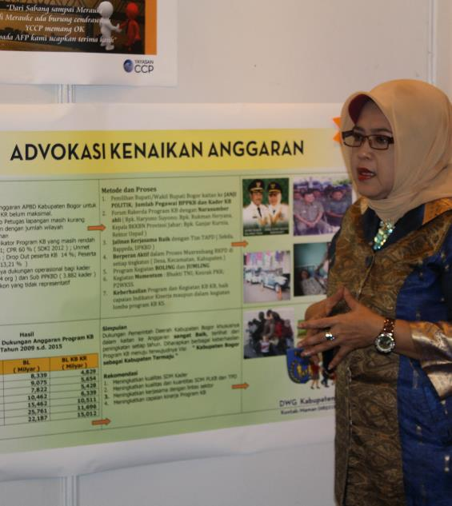
ICMM Project Overview
Implemented in 2
provinces in Indonesia
October 2012–
November 2016
Determine effectiveness
of evidence-based advocacy
to improve access to and
use of LARCs and PMs
A member of the Bogor DWG explains her poster during the knowledge-sharing meeting. © 2014 Sarah Harlan, JHUCCP.
Notes:
The Improving Contraceptive Method Mix (ICMM) project in Indonesia was implemented in 2 provinces between October 2012 and November 2016. The project was designed to determine the effectiveness of using evidence-based advocacy geared toward governmental and NGO leaders to improve access to and use of long-acting reversible contraceptives (LARCs) and permanent methods (PMs) at the district level.

Slide 4
Step 1: ICMM Assesses Needs
Needs assessment methods:
Project baseline assessment
Consultations with key stakeholders
Desk review
Notes:
The first step in the KM Road Map is to assess the needs of the health problem or challenge. This includes understanding the challenge or problem through a variety of mechanisms, identifying if and how KM might be able to help, and producing a needs assessment report and a problem statement. All other steps progress from the findings of the needs assessment. Therefore, this step should be allotted appropriate time in order to have a complete picture of the health problem and potential solutions. But even if you have limited time and budget, you can still take some time to think through all the issues, barriers, and facilitating factors to using and sharing knowledge by, for example, reviewing existing data and consulting with key stakeholders.
The ICMM project started with a needs assessment to identify the health problem and how KM could help solve it. Advocacy was identified as an important strategy to reinvigorate family planning program efforts, which had stalled at the district and village levels, partly due to decentralization of health services. Evidence about women’s and couple’s attitudes toward family planning and their preferences for certain methods was also needed. KM was seen as a bridge between those advocacy and research activities.
The project set out to identify what kinds of information related to family planning that service providers and decision makers needed. They also wanted to understand the existing KM channels used by these key audiences to share knowledge. And the facilitating factors and barriers to accessing, sharing, and using knowledge. The project assessed needs through several methods including:
-Project baseline assessment to examine knowledge, attitudes, and practices related to LARCs and PMs among clients, providers, and decision makers.
-Consultations with colleagues and partners at the national and district levels to better understand the knowledge needs of community-level decision makers
-Desk review of existing documentation, such as Demographic and Health Survey data; service data from the District Health Office and health facilities; and relevant project reports.

Slide 5
Step 1. ICMM Needs Assessment Findings
Barriers to KM: Lack of formal system for information sharing, limited Internet connectivity and resources
Facilitators factors: Informal networks within each district facilitated information sharing
KM channels:
Regional stakeholder meetings
Newsletters
Online communities of practice
Partner websites
Notes:
The needs assessment identified barriers to KM and facilitating factors.
-Barriers to KM included the lack of a system for sharing information among district-level stakeholders, limited Internet connectivity and resources in most areas restricted set up of an online sharing platform.
-Facilitating factors included the existence of informal networks within each district that allowed decision makers to share information with each other.
The needs assessment also identified active KM channels for providers and program managers. These included regional stakeholder meetings, newsletters, online communities of practice, and partner websites. Local decision makers preferred exchanging information through in-person meetings. These were effective but expensive and not always practical to convene. Email and mobile phones were used to exchange files and schedule meetings.

Slide 6
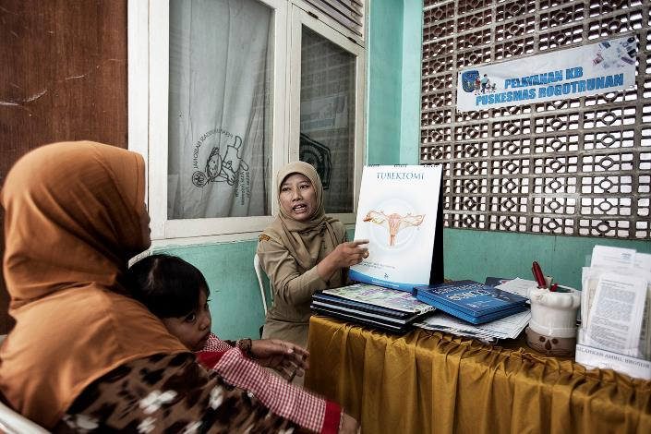
Step 1. ICMM Needs Assessment Overall Findings
Need to hold basic workshops and seminars on key family planning topics
Need to revitalize district- and community-level networks for information sharing
Photo Credit: K4Health

Slide 7
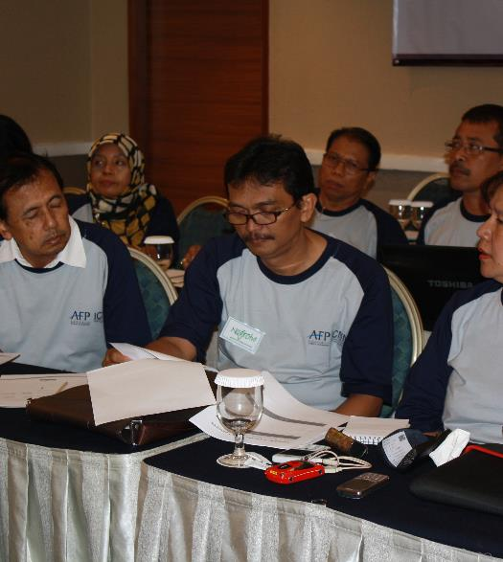
Step 2: Key Components of ICMM’s Strategy
KM objectives: Revitalize working groups; Convene research dissemination meetings; Conduct Net-Mapping
Audiences: Government authorities
Theoretical framework: Diffusion of innovations
KM tools and techniques: Net-Mapping, district working group meetings, fact sheets/research briefs, email listservs
Budget: ~10% dedicated to KM
Photo Credit: K4Health
Notes:
Step 2 of the KM Road Map is to design a KM strategy. A KM strategy should define the key audiences of the KM tools and techniques that you will be developing, your KM objectives, the specific KM approaches you will be using, a work plan or implementation plan, a monitoring and evaluation plan, and a budget.
The ICMM project created a strategic plan that would help them to address their KM needs.
The project created several KM objectives. For example, one KM objective was that by April 2013, they wanted to create/revitalize six district-level working groups of five to seven family planning champions each to share knowledge and help members advocate for funding and supportive policies, such as encouraging midwives to obtrain training on insertion of intrauterine devices and implants. Another objective was to hold 6 research dissemination meetings by Sep. 2013 to explain and discuss baseline research findings and help the district working groups determine priorities in meeting contraceptive demand. Another early objective was to conduct 6 Net-Mapping exercises by October 2013 that could be used to develop tailored advocacy work plans.
The primary audience identified for the KM activities was government authorities, including the Ministry of Health, the District-Level Family Planning Board, and the Ministry of Finance.
The KM tools and techniques they aimed to use were:
Net-Mapping to understand information flows between community actors and facilitate information sharing
Regular district working group meetings
Facts sheets and research briefs, tailored to the district/ community level, to help decision makers understand family planning indicators and make decisions accordingly.
Updates from each project district, sent via email listservs and online portals.
All in all, the information and communication technologies that the project planned to depend on were very low-tech, focusing on email listservs and websites. Much of the KM communication was planned to happen via face-to-face meetings.
In terms of budget, roughly 10% of the project’s budget was dedicated to KM activities.
The project developed an annual work plan as well as an M&E plan. Sample monitoring indicators for the KM activities included the number of dissemination meetings held and the number of research briefs produced.
Finally, the project held launch events in each project district to introduce the research, advocacy, and KM components of the project to the district working groups.

Slide 8
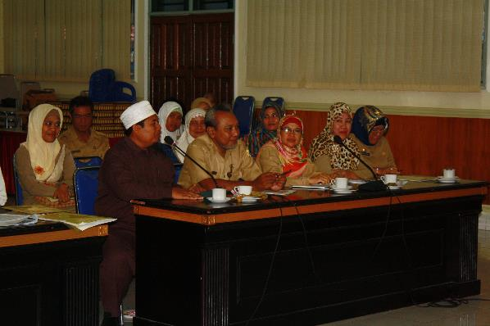
Step 3: ICMM Creates KM Tools and Techniques
Fact sheets/briefs
Case studies
Workshops
Listserv
Annual share fairs
FP Voices storytelling interviews
Photo Credit: K4Health
Notes:
Step 3 in the KM Road Map is to Create and Iterate. The goal of Step 3 is to develop new, or tailor existing, KM tools and techniques that will help you achieve the goals you set forth in your KM strategy.
The ICMM project identified their KM team as members from both the research and advocacy teams. The research team provided the data, while the advocacy experts provided information about which formats were most preferred by the primary audience. The ICMM project manager, serving as the KM lead, worked with the project director and the two principal investigators (based in Baltimore and Indonesia) to synthesize and produce the materials.
The main KM tools and techniques they developed were:
-Fact sheets and briefs that summarized key family planning indicators and funding for each district and messages that government authorities could use to promote family planning.
-Case studies that highlighted challenges and solutions, distributed to family planning stakeholders such as district health officials
-Workshops and discussion sessions, tailored to each district to develop their capacity in technical family planning areas, such as the demographic dividend
-Listserv to share practical information with each district working group
-Annual share fairs to share advocacy lessons learned
-”Family Planning Voices” storytelling interviews with 22 individuals involved in the project’s advocacy work
The project worked direct with the district working groups to ensure the various KM tools and techniques met their needs, e.g., project staff got their feedback about the tools at district working group monthly meetings. The project did not move forward with the idea of developing an online portal to share information because the district working group expressed a preference for in-person meetings. This feedback prompoted the project to use more interactive sharing mechanisms like share fairs.
]
Based on audience feedback, the team tailored the products to include more district-level information, such as data about family planning funding per district, and key messages that government officials could use to promote family planning among their colleagues.

Slide 9
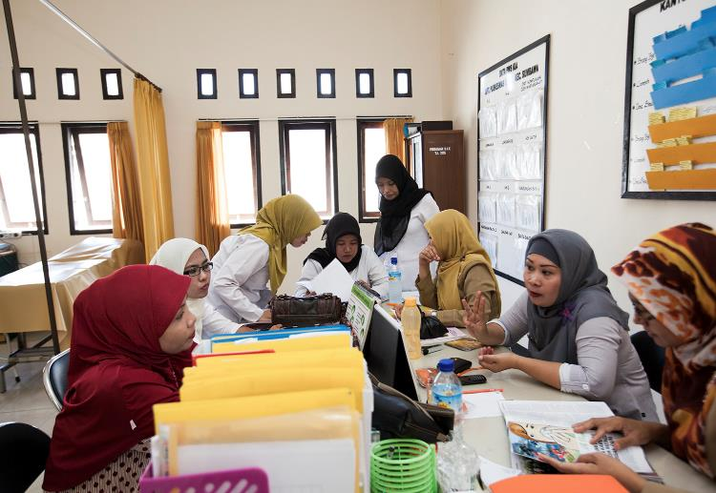
Step 4: ICMM Stakeholders Use Knowledge to Advocate Increased Family Planning Access
Held meetings to keep the team updated on progress
Collected monitoring data every 6 months
Adapted the project activities based on monitoring data and other feedback
Photo Credit: K4Health
Notes:
Step 4 in the KM Road Map is to Mobilize and Monitor. This includes the implementation of KM methods, tools, and events and the monitoring of activities. Adapting the activities, methods, and tools as needed is an important feedback mechanism of this step. The goals of this step are to create an integrated set of KM activities and a plan for adaption.
The ICMM project implemented Step 4 by assessing what was working well and what needed improvement. They held several types of meetings throughout the project with different stakeholders to keep everyone updated on progress during implementation.
The project collected monitoring data every 6 months to assess progress. Most KM indicators related to process data, such as how many fact sheets were produced or how many participants attended the share fairs. Using monitoring data, the ICMM team decided to focus on the in-person knowledge exchange events rather than online forums, so they held annual share fairs based on the success of the first share fair. In subsequent share fairs, the team included more time for district work planning based on feedback received on the first share fair.
Note that this step is responsive to changing conditions on the ground, and acknowledges that rarely does a project remain static during its implementation.

Slide 10
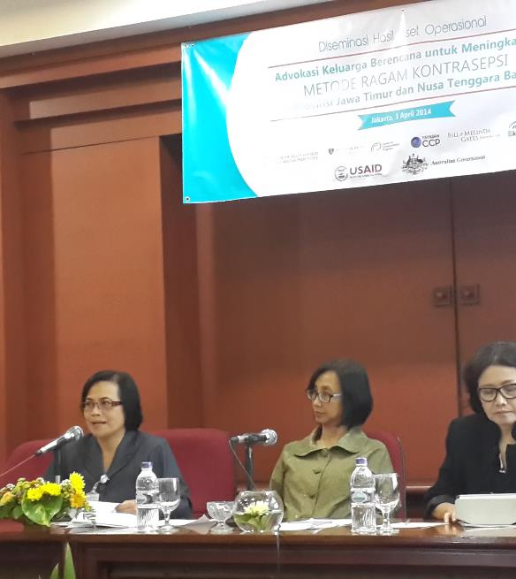
Step 5: ICMM Shares Evaluations Findings
KM indicators’ influence on initial program outcomes
Evaluation design: quasi-experimental (intervention+comparsion; baseline+endline data)
Photo Credit: K4Health
Notes:
Step 5 in the KM Road Map is to Evaluate and Evolve, to see how well you achieved your KM objectives. This step includes dissemination events and production of publications in various formats, such as reports, infographics, or videos, to share your evaluation findings, as well as a discussion of next steps for the project.
The ICMM project completed an evaluation of their project using a quasi-experimental design: the six ICMM project districts served as intervention groups and each district was matched with a non-randomly selected control group. Baseline and endline quantitative surveys of currently married women of reproductive age (ages 15-49) were conducted in each of the intervention and control group areas.
The KM indicators included in the evaluation related to the program’s initial outcomes: service provider and policy maker knowledge, attitudes, and practices around long-acting reversible contraceptives (LARCs) and permanent methods (PMs).

Slide 11
Step 5: Key ICMM Evaluations Findings
Women in intervention groups were more likely than those in comparison groups to:
Recall correct messages about family planning
Have LARCs and PMs recommended by a family planning provider (suggesting improvement in provider knowledge)
District working groups reported using the research briefs to advocate improved access to LARCs and PMs
Notes:
Some of the key findings of ICMM included the following:
-Women in intervention groups were more likely than those in comparison groups to recall correct messages about family planning and to correctly identify that LARCs and PMs were appropriate methods for limiting births.
-There also appeared to be changes in provider behaviors: women in intervention groups were more likely to have LARCs and PMs recommended by a family planning provider, suggesting improvement in providers’ knowledge after the ICMM intervention.
-Anectodal evidence also suggested positive outcomes of the project’s KM interventions. For example, district working groups reported using the research briefs to advocate improved access to LARCs and PMs by, for example, working with religious leaders to improve their knowledge of different family planning methods.

Slide 12
Step 5: ICMM Shares Evaluations Findings
National-level dissemination meeting
Research briefs
Photo slideshow
Storytelling collection: fpvoices.org and printed booklet
Case studies
Journal articles
Notes:
ICMM used a variety of formats to share their evaluation findings:
-National dissemination meeting: All key stakeholders involved in the project were invited (e.g., district working groups, champions from the Ministry of Health, National Population and Family Planning Board, other governmental bodies). Paricipants discussed how to apply best practices from the project (e.g., engaging religious leaders, youth organizations) to future family planning projects in Indonesia.
-Other formats as listed on the slide

Slide 13
Questions? Comments?
© 2014 Biswajit, Courtesy of Photoshare

