Slide 1
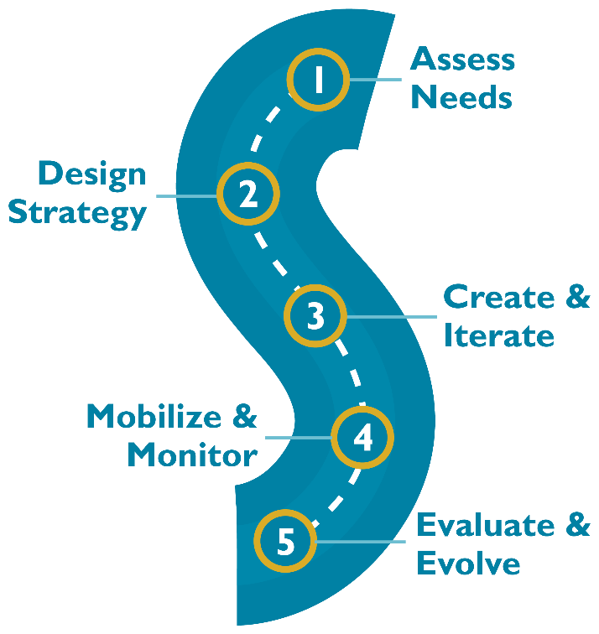
Knowledge Management Road Map: An Introduction to the Systematic Process
Notes:
The KM Road Map was developed by the Knowledge for Health Project in 2016. The Road Map is a five-step systematic process for generating, collecting, analyzing, synthesizing, and sharing knowledge. It can be used to guide health workers and professionals in applying KM systematically and strategically in their programs. This presentation will provide an overview of the KM Road Map.
TRAINER NOTE: The slides in this presentation are meant to be an introduction to the KM Road Map. Please refer to the Building Better Programs Guide for additional details if needed (https://www.kmtraining.org/resources/building-better-programs). There are also additional training modules included in the KM Training Package to delve into the details of each step of the KM Road Map.

Slide 2
Step 1: Assess Needs
Understand health challenge or problem
Identify if and how KM can help.
Output:
Needs assessment report
Succinct problem statement

Slide 3
Step 2: Design Strategy
Create a strategy
KM objectives
Key audiences
KM approaches
Work plan
Budget
M&E plan
Output:
Strategy, work plan, and M&E plan

Slide 4
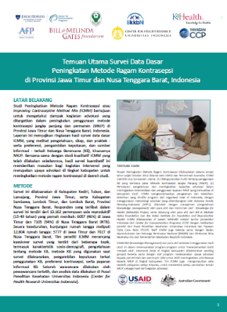
Step 3: Create and Iterate
Develop/adapt KM tools and techniques to meet knowledge needs and fill gaps
Outputs:
KM methods, tools, and events tailored to specific needs and ready for dissemination/ implementation

Slide 5
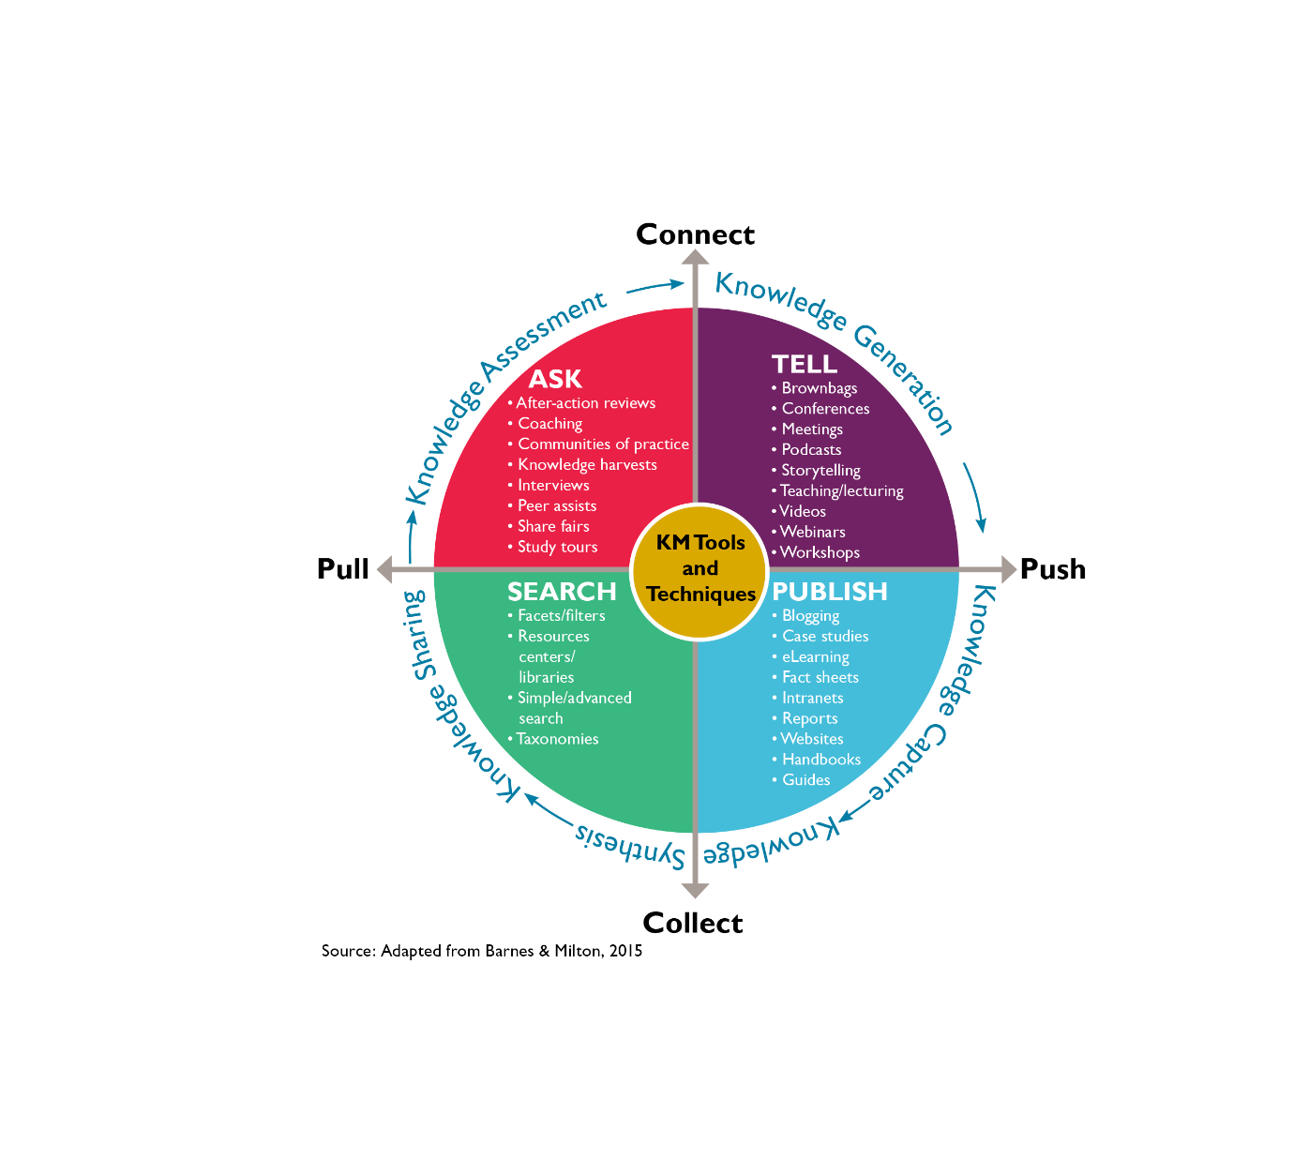
KM Tools and Techniques Matrix
Notes:
KM tools and techniques fall on a continuum from collecting information to connecting people to that information as well as “pushing” information to people and providing them with tools so they can “pull” the information themselves. They can be thought of in terms of:
· Asking approaches - after-action reviews, knowledge cafés, and peer assists, other types of events and meetings, which can be helpful for eliciting tacit knowledge
· Telling approaches - conferences, webinars, and workshops that are useful for conveying knowledge to defined groups of people
· Publishing approaches - job aids, eLearning courses, or websites; these are efficient tools for sharing explicit knowledge with large groups of people
· Searching approaches - websites, libraries or databases, which allow people to pull the information they need, when they need it

Slide 6
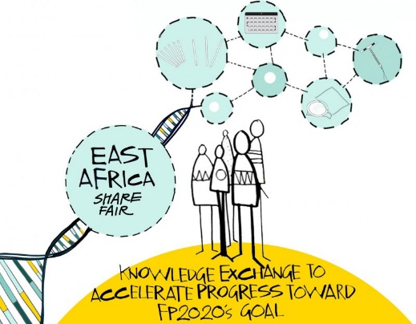
Examples of Asking Approaches
East Africa Share Fair: Knowledge Exchange to Accelerate Progress Toward FP2020’s Goal brought together 50 representatives from Kenya, Tanzania, Uganda, the United States, and Zambia to share ideas for future collaboration in family planning; the share fair featured panel presentations, breakout sessions, knowledge cafés, and discussions.
East Africa Share Fair Peer Assist: The East Africa Share Fair included a half-day peer assist event where selected teams shared a KM-related challenge with peers who then offered insights and helpful suggestions.
After-action review conducted by the East, Central and Southern Africa-Health Community (ECSA-HC) for the 62nd Health Ministers Conference
Notes:
Note to Trainer: Please feel free to replace the examples on the slide with relevant, local examples.

Slide 7
More Examples of Asking Approaches
Global Health Knowledge Collaborative is an online and face-to-face community of practice of KM professionals

Slide 8
Examples of Telling Approaches
Global Health Digital Forum 2016, the third annual conference focused on digital and connected health in low- and middle-income countries, convened more than 425 collaborators working in global digital health
FP Voices, a storytelling platform produced by K4Health, FP2020, and other partners to document and share stories from individuals around the world who are passionate about family planning.
Notes:
Conferences in and of themselves are a prime example of KM.
Note to Trainer: Please feel free to replace the examples on the slide with relevant, local examples.

Slide 9
More Examples of Telling Approaches
Improving Global Public Health Through Knowledge Application, Continuous Learning, and Adaptation: This course introduces participants to the evolving field of KM, organizational learning, and adaptive management in international development through real-life examples of how principles of intentional learning are leading to better development programs and can be applied to strengthen public health systems.
Notes:
Note to Trainer: Please feel free to replace the examples on the slide with relevant, local examples.

Slide 10
Examples of Publishing Approaches
Global Health eLearning Center, a distance learning platform that provides free, self-paced Internet-based courses on a wide range of global health topics.
Do You Know Your Family Planning Choices? wall chart, often referred to as the Family Planning Wall Chart or the “Tiahrt” Chart, contains information about specific contraceptive methods and is intended for health-care providers to use as a reminder for themselves and as an education tool for their clients.
Notes:
Note to Trainer: Please feel free to replace the examples on the slide with relevant, local examples.

Slide 11
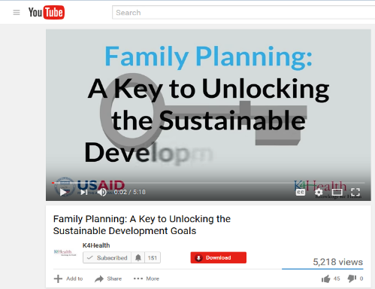
More Examples of Publishing Approaches
Family Planning: A Key to Unlocking the Sustainable Development Goals animation video illustrates how and why family planning is vital to our ability to meet global development challenges, from reducing poverty to slowing climate change to preventing civil unrest.
Notes:
Note to Trainer: Please feel free to replace the examples on the slide with relevant, local examples.

Slide 12
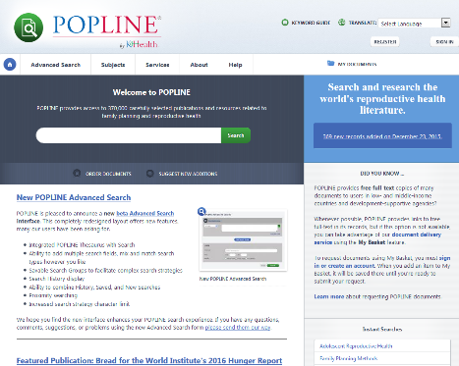
Examples of Searching Approaches
POPLINE taxonomy, or thesaurus of keywords used to index POPLINE documents. POPLINE is an online database containing the world’s most comprehensive collection of population, family planning, and related health and development literature.
mHealth Evidence: This repository was designed to bring together the world’s literature on mHealth to make it easier for program managers, researchers, government leaders, donors, software developers, and other key decision makers to quickly access current state-of-the-art and evidence-based best practices. It includes peer-reviewed and gray literature from low-, middle-, and high-resource settings.
Notes:
Note to Trainer: Please feel free to replace the examples on the slide with relevant, local examples.

Slide 13
More Examples of Searching Approaches
Photoshare online database, a leading source of public health and development photographs, which is free for nonprofit and educational use. Photoshare provides a simple search button that persists on each page of the website, as well as an advanced search option for users who want to limit their search by photo orientation, resolution, and year.
Notes:
Note to Trainer: Please feel free to replace the examples on the slide with relevant, local examples.

Slide 14
Step 4: Mobilize and Monitor
Implement KM methods, tools, and events
Monitor activities and adapt if necessary
Outputs:
Integrated set of KM activities
Monitoring tracking tool
Plan for adaptation

Slide 15
Step 5: Evaluate and Evolve
Evaluate to see how well you achieved your KM objectives
Outputs:
Dissemination event(s)
Publication(s)
Other formats (e.g., infographic, data visualization, or video)
Discussion of next steps

Slide 16
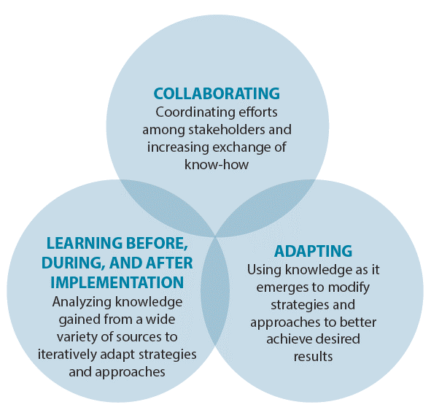
Cross-Cutting Concepts
Notes:
In addition to the five key steps, the KM Road Map incorporates the three cross-cutting concepts of collaborating, learning, and adapting, which provide a flexible framework to support and enhance learning as promoted by the Bureau for Policy, Planning, and Learning at the United States Agency for International Development. Let’s review these 3 concepts again now that we have a better understanding of the five-step KM Road Map process and see how CLA can be applied at each step.
Collaborating involves engaging with key stakeholders, local thought leaders, and development actors to understand the local context, design programs appropriately, and keep abreast of changes. It also involves coordinating efforts within an organization and among partners and other stakeholders to increase synergies and extend the organization’s influence and impact beyond its project funding.
During Step 1, collaborating happens when stakeholders are involved in planning the needs assessment and also when they are included as respondents to the needs assessment. During Step 2, the KM strategy should be designed with key stakeholders involved to ensure inclusion and ownership. During Step 3, an interdisciplinary KM team will likely need to be developed to create KM tools and techniques. During Step 4, implementation and monitoring require coordinating with team members, partners, and other stakeholders. Finally in Step 5, stakeholders should be engaged early on to decide what type of evaluation to conduct, and later on to help disseminate and interpret the evaluation findings.
Learning occurs before, during, and after project implementation. When health professionals learn, they generate, capture, share, analyze, and apply information and knowledge to improve programs. Programs should pause periodically to reflect on and synthesize new learning, and employ participatory development methodologies that catalyze learning for stakeholders.
(Refer to Table 1 in the Building Better Programs Guide [https://www.kmtraining.org/resources/building-better-programs] to see how Learning occurs during each step in the KM Road Map.)
Adapting the program by applying learning and making iterative course corrections during implementation to respond to changing needs, priorities, and realities. Such adaptations are critical to increasing the impact of programs.
(Refer to Table 1 in the Building Better Programs Guide [https://www.kmtraining.org/resources/building-better-programs] to see how Adaptation occurs during each step in the KM Road Map.)

Slide 17
The KM Collection of Resources
KM Road Map: The five-step process for KM that is the foundation for all materials.
KM Pocket Guide: This resource briefly introduces the five steps of the KM Road Map.
Building Better Programs: Detailed, step-by-step guidance on how to develop and implement a KM strategy for health programs, building on the primer.
KM Training Package: Comprehensive set of KM training materials, geared mostly to trainers, but trainees may also find it helpful to access various tools and templates included for each step of the KM Road Map.
Notes:
In the next presentation, we will provide a practical program example of how a program in Indonesia put KM into action.
Trainer may want to inform participants at this point of the KM Collection of resources provided by the K4Health Project that can help them apply KM in their programs. In addition to the KM Road Map

