Slide 1
Step 1: Introduction to Assessing Needs
Notes:
The goal of Step 1 is to understand the extent of the health program challenge and identify how KM can help solve it. Specifically, the goal of this foundational step is to discover the information needs and gaps of your health program staff that, if addressed, could help improve the effectiveness of your program. Depending on the findings, KM may be a central part of the solution or it could play a supporting role to other strategies.
TRAINER NOTE: The Training Package will not lead participants in the actual development of a needs assessment

Slide 2
Step 1: Assess Needs
Objectives of this step:
Understand why it is important to assess knowledge needs in your program.
Explain the purpose and use of common KM assessment methodologies.
Review process for implementing knowledge needs assessment plan for your health program.
Notes:
During this presentation I will review topics and present a variety of solutions and answers. As I review these topics, make notes in your workbook. In many cases, these thoughts can help form the start of the process. It’s likely that you will need to confer with others on your team or in your organization.

Slide 3
What Is a Needs Assessment?
A technique for:
Assessing the current capacity of knowledge management systems and processes
Determining the current preferences and information-seeking behavior of your primary user group or audience
Identifying gaps and priorities to address in order to meet knowledge management needs of audiences
Notes:
Customized based on target users and program goals
Refers to assessing needs of external audiences

Slide 4
Why Conduct a Needs Assessment?
Needs Assessment can help KM practitioners to improve the quality of decisions and performance outcomes by aligning KM activities with assessment findings.
More specifically through needs assessment, you can:
Develop evidence-based and needs-driven programs and policies for your users/audiences.
Address knowledge gaps and improve knowledge exchange systems and processes
Notes:
A systematic review of knowledge assets and how they contribute to your organisation’s key activities.
Covers both explicit knowledge (information in documents and data) and tacit knowledge (people’s skills, experience and abilities).
Identifies knowledge flows and knowledge gaps.
Conducted at the beginning of a project or activity to inform its direction/course
SOURCE: Straits Knowledge 2014

Slide 5
Four Steps for Getting Started
Understand knowledge needs, gaps, networks, key stakeholders, and resources:
Identify purpose, objectives, and key questions of the assessment
Identify the audience
Review what is already known
Plan to collect new data if necessary and if resources are available

Slide 6
Identify Purpose, Objectives, and Key Questions of the Assessment
Before conducting a knowledge needs assessment, program managers should identify the purpose and objectives of the assessment and determine the intended audience (i.e., whose knowledge needs will be studied).
Will the assessment identify knowledge needs and assets within your organization?
Or will the assessment identify knowledge needs of current or potential consumers of your organization’s resources, or those of another external stakeholder group?
Notes:
Managers should then consider the question(s) that they would like the assessment to answer. Defining the question(s) helps managers draft relevant objectives and helps to ensure that everyone involved in the assessment understands the purpose, focus, and scope of the assessment. Defining these questions also helps program managers decide which assessment methodology to use and how to collect and analyze data.

Slide 7
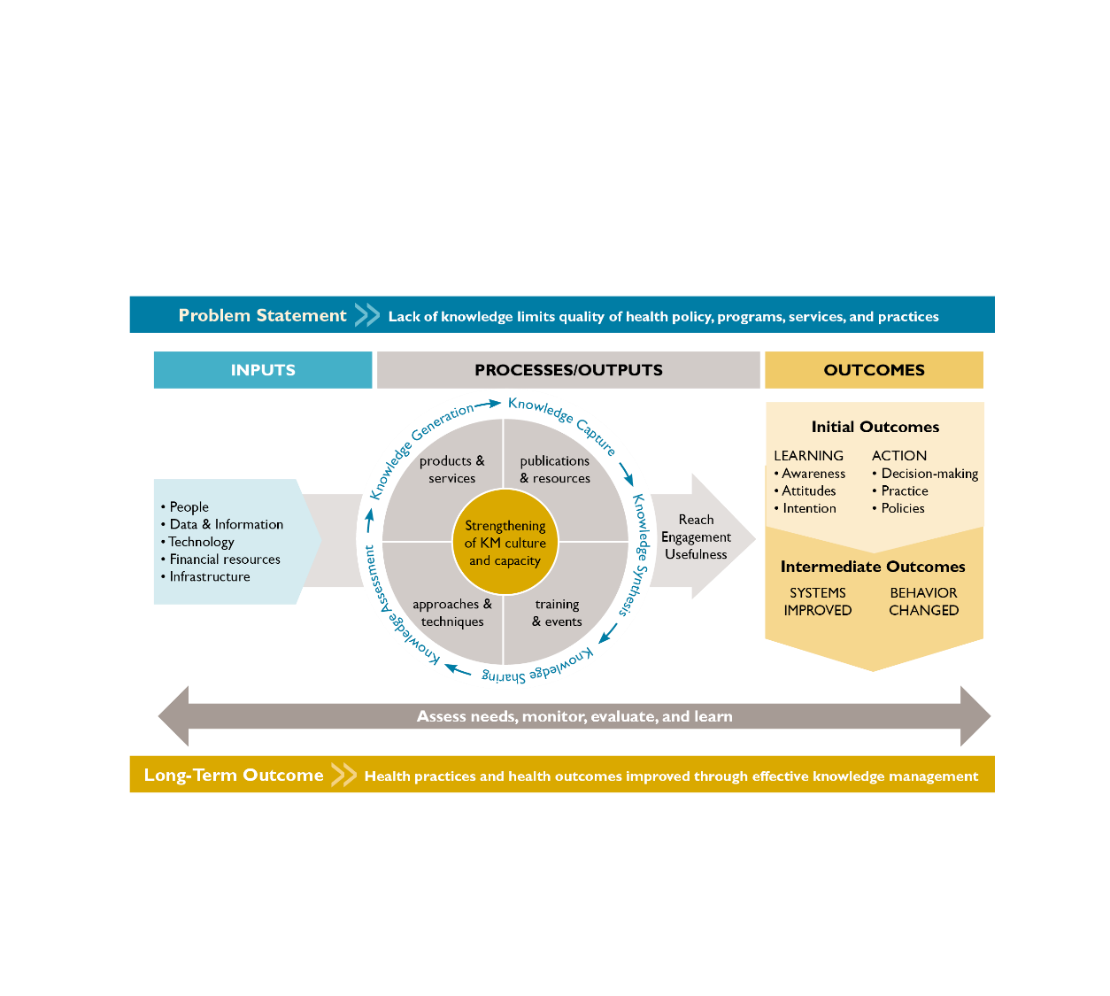
Knowledge Management for Global Health Logic Model
Needs Assessment looks at the inputs and processes levels to inform strategy design and activity development
Notes:
The Knowledge Management for Global Health (KM4GH) Logic Model (Figure 1), developed by the Global Health Knowledge Collaborative to assist with planning and evaluating KM interventions in global health programs, provides a useful framework for focusing the scope of your needs assessment by outlining potential areas of focus, from inputs and processes to outputs and outcomes:
Inputs include the resources invested in or used by a KM intervention, such as human and financial resources, technology, and infrastructure.
These inputs feed into five processes that together make up the KM cycle: knowledge assessment, generation, capture, synthesis, and sharing.
These processes work together to create the key outputs—KM products and approaches ranging from websites and publications to training workshops and communities of practice—which are measured in terms of reach, engagement, and usefulness.
Finally, the logic model portrays the benefits to users relating to their knowledge, skills, attitudes, behaviors, or health conditions; these benefits, or outcomes, are expected at three levels (initial, intermediate, and long-term).
NOTE TO TRAINER: See Step 5: Evaluate and Evolve for more information about expected outcomes of KM interventions, and the Guide to Monitoring and Evaluating Knowledge Management in Global Health Programs for a more comprehensive description of the logic model overall (Ohkubo et al., 2013).

Slide 8
Identify the Audience
Clearly define the primary audience
Are you gathering information on health care providers or program managers?
At what level of the health system does your audience operate?
Are there specific issues about this audience that makes it more important to assess their knowledge needs than other audiences?
Does this audience have substantial barriers to accessing and using knowledge to inform their work?
How do the potential audiences relate to national, regional, and local priorities for improving health programs and outcomes?
Consider gender disparities in access to information
Notes:
Delve deeper and identify specific subgroups (O’Sullivan et al., 2003; DHHS, 2008), for instance, midwives working at the clinic level, community health workers in a particular geographic region, or facility managers. Think through why you are selecting one particular audience over another (Cavanagh & Chadwick, 2005)

Slide 9
Review What Is Already Known
Common Sources of Existing Knowledge
Demographic and Health
Survey data
National census data
Service statistics
Literature reviews
Evaluation reports of other
relevant health programs
Management reports
Policy documents
Training needs assessments
Action plans
Before collecting new data, conduct a desk review to see if the data and information you need already exist.
For example, you can conduct a literature search or reach out to colleagues to determine if reports or publications have collected information regarding the knowledge needs of your defined audience.
Notes:
Seeking, collecting, and analyzing existing data and information are relatively inexpensive ways to learn about the needs of audiences.
TRAINER NOTE: Ask participants what other types of existing sources they might draw from

Slide 10
Plan to Collect New Data, if Necessary and if Resources Are Available
If the information you need does not already exist, you will need to collect original data, both quantitatively and qualitatively. It’s important to consider both data collection approaches. Some common methods for collecting data on knowledge needs include:
Environment scans
Interviews with key informants
Surveys
Focus group discussions
Network Mapping (or Net-Map)
Notes:
Network Mapping (or Net-Map), a social mapping tool that combines the visual aspects of creating a map with either an individual or group interview, is a particularly useful method for collecting data on key questions around knowledge needs and knowledge sharing, for example, how information about a particular topic is shared between health workers at different levels of the health system. More information about these methodological approaches can be found in the Guide to Monitoring and Evaluating Knowledge Management in Global Health Programs (Ohkubo et al., 2013).

Slide 11
Some Common Objections and Responses
Common Objection | Possible Response
We already know what the needs of the audience are | Many times, the needs are not so clear—there may be differences in opinions between stakeholders. In these cases, it’s worth conducting a formal needs assessment to clarify what the issues are or build in activities to further refine needs as part of start-up activities for the KM intervention.
We’re busy. We want to get going! | Taking the time up front to do a needs assessment will help ensure that the strategy and activities you put in place (and resources you spend) are meeting a real need.
We don’t have time to do a survey | We’re not suggesting you have to conduct a full-scale scientific survey. You can collect useful data in a matter of hours. For example, you can go to a meeting attended by your key audience and ask them a few questions. There are varying degrees of comprehensiveness in terms of conducting needs assessments.
We don’t know how to do it | It doesn’t have to be perfect or complicated! Remember, any type of information gathering is almost always better than no information gathering at all. Look for tools that you can adapt in the accompanying Training Package.
Notes:
You may encounter objections to collecting new data. Some common objections and responses are outlined here (University of Kansas, 2016).
Sometimes the need is very clear, and no one has any doubt about it. In those cases, you don’t need to collect new data. But be sure you take the time to think through all the issues, barriers, and facilitating factors and talk to key stakeholders to ensure you aren’t missing anything.
TIP: Any kind of information gathering is almost always better than no information gathering at all!

Slide 12
Supplement: K4Health Needs Assessment Guide
Published: 2011 (updated in 2013)
Background: Based on K4Health’s experiences conducting needs assessments at both the global and country levels: Malawi, Senegal, Peru, Ethiopia, India
Contents:
Guidance for using various methodologies
Case studies
Tools, instruments, and training materials
Tips for disseminating results
Notes:
For details, review the supplement: K4Health Guide for Conducting Health Information Needs Assessments. It was developed for four purposes:
To share a methodology for conducting assessments of FP/RH information needs at the global and country levels.
To share lessons learned, present overall findings from K4Health needs assessments, and provide tips for others conducting similar assessments.
To provide sample needs assessment instruments, templates, and training materials, which can be adapted for future assessments.
To discuss dissemination of results, including materials and meetings.
https://www.k4health.org/sites/default/files/k4health-guide-for-conducting-health-information-needs-assessments-oct2015-update.pdf

