Slide 1
eLearning
Instructional Design and Course Development Process
Notes:
This presentation on eLearning draws from the experience of the Knowledge for Health (K4Health) Project in managing the Global Health eLearning (GHeL) Center (https://www.globalhealthlearning.org/) over many years.

Slide 2
Learning Objectives
Recall instructional design approach and examples for effectively writing eLearning content
List key components of an eLearning course
Recall how to draft a purpose statements, high-level learning objectives, and a course outline
List key roles, responsibilities of an eLearning team
Recall important aspects in developing a timeline

Slide 3
What is eLearning?
Multiple definitions of eLearning and related terms
Lack of universal agreement or hierarchy

Slide 4
Defining eLearning
Narrow View
eLearning is computer-based training (CBT)
Sources:
Programmed instruction
Computer-assisted instructional systems
Interactive multimedia
Broad View
eLearning is any electronic means of delivering learning
Sources:
“e” – everything (e-commerce, e-health, etc.)
Media proliferation (satellite, Internet, etc.)
Network communication (email, computer conferencing)

Slide 5
Your Experience With eLearning
What is your experience with eLearning?
Have you taken any online courses before?
Have you authored online courses?
Notes:
With all that in mind, we’d like to learn more about you. (Ask the questions listed on the slide.)

Slide 6
Instructional Design Approach

Slide 7
Course Development Approach
Instructional Design
Learner–centric
Focus learning on learning and performance objectives
Filter content and avoid overload
Working Together
Agreed-upon workflows
Open lines of communication
Mutual understanding of schedule and timeline constraints
Iterative process of course development
Notes:
There is a need to think about the learner as well as the content and try to focus more on what's really relevant and needed information for the learner to know.

Slide 8
Tools for Developing and Hosting eLearning Courses
Content Management
Allows course authors to create a course online with links to documents, graphics, quizzes, games, etc.
Requires no IT skills to use.
Learning Management
Where learners go to access the course online
Requires registration so that course attempts and completions are recorded
Tracks all final exam responses plus the time it takes to answer a question
Provides transcript and certificate for successful completion

Slide 9
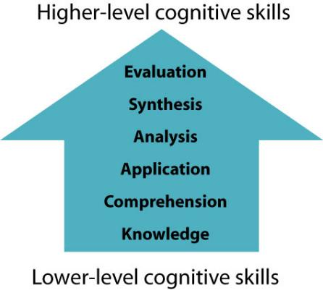
Instructional Design Framework Bloom’s Taxonomy
Notes:
Bloom’s Taxonomy is an important educational framework. It helps authors in designing content that maps to specific cognitive skills through the development of performance tasks, quiz questions, and feedback.
The majority of courses generally develop/assess lower levels of Bloom’s Taxonomy that are more Knowledge and Comprehension-based. However, you can include a variety of examples and case studies so that they are more grounded in the learners’ reality and provide them with examples as to how concepts have been applied in similar settings to assess the higher-level cognitive skills.

Slide 10
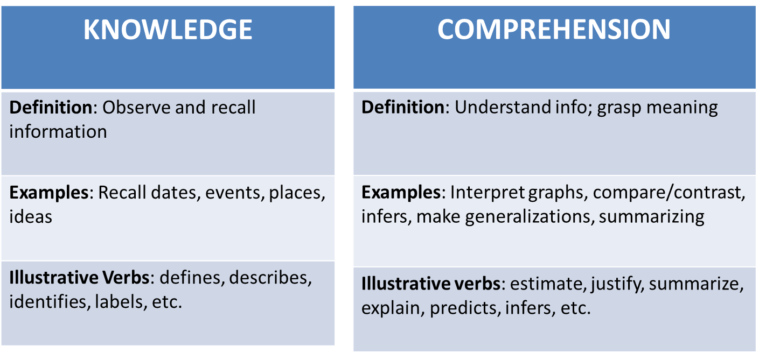
What Does This Mean for Content Development?
Notes:
Courses are designed specifically to ensure the learner’s knowledge, comprehension, and critical thinking about a particular topic.

Slide 11
Determine Your Audience
Who is your target audience?
What are their main job responsibilities?

Slide 12
Determine the Audience’s Capabilities
How are they going to access this course?
Internet, CD-ROM, personal/work computer, resource center
How comfortable are they with working on computers?
What is their connectivity right now?
What is the connectivity trend?
Are they moving forward quickly?

Slide 13
Issues of Access – Example From Survey
Do you have access to a computer at:
Where do you access the computer most frequently?
Notes:
One way to find out information about your audience is to conduct a survey and ask key questions like what kind of access they have to computers, where they usually access computers, etc. In this example, a questionnaire was sent to Medical Laboratory Scientists in a particular country to answer some of these questions/provide insights. K4Health conducted such a survey among this group and found that the majority (90%) had access to computers with Internet connection and were somewhat to very comfortable in using computers (90%) and so we decided that eLearning was a feasible approach.

Slide 14
Course Development Process

Slide 15
Roles and Responsibilities
Course authors
Person(s) responsible for writing all course content
Course manager
Person responsible for managing and monitoring the course development process
Person responsible for conducting the QAT, reviewing the spelling, grammar, and formatting of the course
Technical reviewer/approver
Person(s) responsible for reviewing the accuracy of the technical content of the course
Person responsible for providing final “signing off” on course so that it can be published online
Notes:
QAT: quality assurance testing

Slide 16
Phases in the Course Development Process
Planning and start-up
Course development
Monitoring & Evaluation
Phase 1
Phase 1
2
3
4
5
Course design
Course delivery

Slide 17
Phase 1: Planning and Start-Up
Hold course kick-off meeting
Assign and/or confirm the eLearning course team
Identify course audience(s)
Develop course purpose statement and learning objectives
Develop course outlines based on key concepts
Notes:
We’ll focus on the last two items.

Slide 18
Purpose Statement
Briefly introduces the importance of the topic
States the overarching rationale for the course (the “so what?”), followed by the main learning objective of the course.

Slide 19
Purpose Statement Example Geographic Approaches to Global Health
It is important to harness geography to manage, analyze, and leverage spatial data effectively when planning, monitoring, and evaluating health sector programs.
Through this course, learners will gain an understanding of how to use spatial data to enhance the decision-making process for health program implementation in limited resource settings.

Slide 20
Purpose Statement Example Female Genital Mutilation/Cutting
Notes:
Okay, now let’s review the purpose statement of the sample Female Genital Mutilation/Cutting course provided on this slide. What do you like about it? What don’t you like?
Let’s think about the target audience and write who they are down. Does this purpose statement meet their learning needs related to ___________?

Slide 21
High-Level Objectives
Communicate the instructional goals of the entire course
Example: By the end of this course, the learner will be able to understand geography as a unifying framework and GIS as a tool to collect, link, analyze, visualize, manage, and share data and information, within a public health context.
Notes:
Once you’ve developed your purpose statement, you can move on to developing your high-level objectives.
GIS: geographic information system

Slide 22
Brainstorm Key Concepts
The most important technical or programmatic ideas or questions found in research, among experts, or based on experience that you want to convey in the course.
Notes:
Once you have your high-level objectives, it is now time to brainstorm the key concepts you want to cover in the eLearning course.

Slide 23
Key Concepts → Course Sessions
After brainstorming what you consider appropriate content for the course:
Cluster the concepts together
Select concepts that are:
Timely, useful, and appropriate for your audience
Reasonable to develop in the length of the course
Notes:
These key concepts will become the main topics of your course sessions. You can think of them as chapter headings.

Slide 24
Course Session Example
Course Guide
Session 1 | Introduction
Session 2 | Strategic Role of Geography in Health
Session 3 | Geographic Data
Session 4 | Geographic Tools
Session 5 | Process for Using the Data and Tools
Session 6 | Case Studies
Note: All courses end with a final exam, which typically consists of the majority of questions from the individual session quizzes plus 5-7 new questions.
Notes:
Okay, let’s take some time to jot down the key concepts that you’d like to cover. This ties in directly with thinking about high-level learning objectives since each session should address at least 1-2 high-level learning objectives. You should also be able to craft quiz questions specifically to test whether or not these learning objectives are being met.

Slide 25
Detailed Objectives – Sessions
Provide specific information on what learners are expected to understand as a result of completing a given session within a course
Action-oriented and measurable
Notes:
Once you have identified your course session topics, you should then develop detailed objectives for each session.

Slide 26
Detailed Objectives Examples
Name two characteristics that make data geographic.
Identify what distinguishes a fully-featured GIS from a simpler tool.
Recall four factors to consider in using existing geographic data.

Slide 27
Phase 2: Course Design
Develop course outline that’s based on high- and detailed level objectives
Course purpose statement
Key concepts – clustered into course sessions
High-level objectives for each session
Detailed learning objectives for each session/objective
Set up course architecture
Notes:
For our purposes, it’s most important that we finalize the course purpose statement, course sessions, and high-level learning objectives.

Slide 28
Phase 3: Course Development
Synthesize background materials
Create course sessions and draft content
Conduct technical review and QAT of course
Approve course content

Slide 29
Writing the Course
Write course content
Create glossary terms
Include reference materials
Create or include multimedia
Create quiz questions
Ensure proper citations!
Notes:
This is what it means to write course content. Here’s where I’d like to share with you some good approaches to use when developing/writing content. We’ll go into more detail about each of these items on the following slides.

Slide 30
Best Practices for Writing eLearning Content
Write is critical for a learner to know? Key messages
KISS (Keep It Simple, Seriously).
Condense your sentences. Vary sentences and break up long sentences with short ones.
Keep it scannable. (Most people don’t actually read on the web. They scan, looking for headings, bold keywords, and bullets.)
Make links meaningful.
Notes:
Remember you do not have a lot of space, so always ask yourself: Is it vital to the course and the key concepts that you are trying to portray or simply good to know? It is our job as the Course Manager to remind you of this and make recommendations to synthesize or eliminate content that doesn’t meet this criteria.

Slide 31
Use of Case Studies
https://www.globalhealthlearning.org/course/introduction-early-childhood-development/page/story-laila?erid=node--15872--60
https://www.globalhealthlearning.org/course/good-governance-management-medicines/page/challenge-ethical-personnel-practices-ossarano?erid=node--23280--60
Notes:
Good Governance in the Management of Medicines course on the Global Health eLearning Center presents a case study throughout the course; one in every session that covers each essential session topic
The Introduction to Early Childhood Development course, also on the Global Health eLearning Center, presents a longer case study as its closing session, where users apply their understanding throughout the course.
There are also other variations:
Improving Lives of Young Vulnerable Children and Caregivers applies case study in the middle: http://www.globalhealthlearning.org/course/improving-lives-young-vulnerable-children-and-their/quiz/using-visual-reference-guide-children-household-level?erid=node--22244--60
US Abortion and FP Req presents two case studies at the end: http://www.globalhealthlearning.org/course/us-abortion-and-fp-requirements-2016/page/introduction-case-study-1?erid=node--149--60

Slide 32
Multimedia
https://www.globalhealthlearning.org/course/health-communication-managers/page/what-does-health-communication-look-practice?erid=node--23685%E2%80%9460
https://www.globalhealthlearning.org/course/good-governance-management-medicines/page/challenge-ethical-personnel-practices-ossarano?erid=node--23280--60
Notes:
Many examples, including:
Embedded video (from existing sources)
Animated video
Interactive graphics: Health Communication for Managers
Static images are also extremely effective
Creating your own animated videos and interactive graphics are often costly

Slide 33
DON’T Underestimate Static Images!
Notes:
Static images are also extremely effective at adding greater clarity to a point you’re trying to make.
We can have graphics recreated from existing item, or devise something from scratch.
Photos are also very effective: Photoshare.org offers a great selection
Need to look for Creative Commons license (able to redistribute); and also need to provide credit and description

Slide 34
Creating Quiz Questions
https://www.globalhealthlearning.org/course/improving-health-care-quality/quiz/final-exam?erid=node--151546--60
https://www.globalhealthlearning.org/node/74174/take
Notes:
Quiz questions are most typically in the following formats: true/false, multiple choice, scenario-based, and matching questions. We recommend that come up with questions that relate to the key concepts or detailed learning objectives.
You can decide whether or not you would like pre-tests post-tests questions (for each session). Having both can serve as an added knowledge reinforcement.

Slide 35
Plagiarism
“the act of using another person’s words or ideas without giving credit to that person” (Merriam-Webster dictionary)
Types of Plagriarism:
Word-for-word copying without proper citation
Intertwining your ideas with the author’s without proper citation
Paraphrasing without proper citation
Self-plagiarism: trying to publish the same work in multiple places or using text verbatim without proper citation
Notes:
Proper citation is important to maintain the integrity of these courses, especially since they are open to the scrutiny of other health professionals.
Note that plagiarism includes not only using other people’s words without giving due credit but also their ideas. Also includes tables, figures, images, etc.
You can even be accused of self-plagiarism!
How best to avoid plagiarism then? Generally, paraphrase AND cite.

Slide 36
Use Proper Citations
Photos, graphics, images – Free images (but still have to cite):
Wikimedia Commons: http://commons.wikimedia.org/wiki/Main_Page
Flickr Commons: https://www.flickr.com/commons
Text
Quotation marks if using text verbatim
Citations even if you are paraphrasing the text
Notes:
Photos, graphics, images: Many images, photos, and graphics are copyrighted, including those of the WHO (http://www.who.int/about/licensing/en/). Please make sure that you have permission, in writing, to use those that are copyrighted. Alternatively, you can use publicly available images. A few sites that allow free use of images, with citation, are Wikimedia Commons, Flickr Commons, K4Health’s Photoshare.

Slide 37
Technical Review and QAT
Think about who should be provide course sign-off
And who will conduct the QAT (which includes the following tasks):
Verify citations
Verify references
Check links
Ensure proper spelling and grammar
Ensure consistent formatting
Notes:
Conduct technical review and QAT of course
Approve course content

Slide 38
Phase 4: Course Delivery
Publish and promote course
Consider ways to incorporate course into capacity building activities, such as an online facilitated study group

Slide 39
Phase 5: Monitoring and Evaluation
We also recommend that you collect feedback from users via online course evaluations/surveys
Prioritize user suggestions for future course updates
Does your system allow access to other information (e.g., course completion, Google Analytics)?

Slide 40
Common Authoring Successes
Developing/rebuilding graphics to enrich the content
Setting an agenda and timeline at the beginning
Sharing responsibilities enhanced commitment
Notes:
Things to consider as we discuss the course development process…

Slide 41
Common Authoring Challenges
Not always having access to a computer or access to consistent Internet subscription
Aligning the courses so they have the same amount of information
Technical reviewers sometimes do not quite grasp that the courses were going to be online and so they suggest items that are often not needed (e.g., Table of Contents).
Some reviewers are not specific about the changes they want to see

Slide 42
Common Authoring Challenges
Focusing too much on background information and not on the latest evidence – what is new?
Developing original content
Competing priorities/time management

Slide 43
Public Health eLearning Course Sites
GHeL/PEPFAR eLearning | http://www.globalhealthlearning.org
HRH Global Resource Center | http://www.hrhresourcecenter.org/elearning/index.php
CDC | https://www.cdc.gov/training/development/design/online/index.html
International Federation of Biomedical Laboratory Science | http://www.ifbls.org/index.php/about-ifbls/e-learning
Johns Hopkins Center for Clinical Global Health Education | https://moodle.ccghe.net/
JHSPH OpenCourseWare | http://ocw.jhsph.edu/index.cfm
CDC TRAIN | https://www.train.org/cdctrain/welcome
Global Health Delivery Online (GHDonline) | https://www.ghdonline.org/accounts/signin/?email=jcassani%40jhuccp.org&firstlogin=1
JSI eLearning | http://elearning.jsi.com/index.php
Unite for Sight - Certificate in Global Health | http://www.uniteforsight.org/global-health-university/enroll
MEASURE Evaluation M&E Learning Center | https://www.measureevaluation.org/resources/training/online-courses-and-resources.html
Learn it Live | http://www.learnitlive.com/classes-events/Public-Health/343.html

Slide 44
Questions?

