Slide 1
Communities of Practice (CoPs)
Notes:
This presentation is based on the Knowledge for Health (K4Health) Project’s experiences and lessons learned with managing a range of CoPs over many years.

Slide 2
Learning Objectives
Understand what a CoP is and how it can be used to facilitate knowledge exchange
Understand how to plan for success, what different platforms and techniques can be used, and how to choose what’s best for your audience
Become familiar with some of our lessons learned and challenges by discussing a few examples of active CoPs (mHealth, Social Media for Global Health, and the GHKC)
Notes:
GHKC stands for the Global Health Knowledge Collaborative, an online and face-to-face community of practice of KM professionals.

Slide 3
What Is a CoP?
Notes:
A CoP is a group of individuals who interact over time and are bound together by a shared interest or purpose.
CoPs have the capacity to both share and generate knowledge.

Slide 4
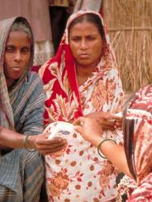
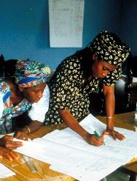
Essential Elements
Held together by “learning” of members
May perform tasks, but tasks do not define the community
Members join in order to learn
Members’ ability to learn together builds trust
Notes:
District working groups, for example, are not necessarily communities of practice – because they usually have a specific workplan, specific tasks. However, if multiple district working groups meet together to share lessons learned and best practices – which is not necessarily task-oriented – this is more of a community of practice, where members are sharing and learning, and that is the goal, not a specific task.

Slide 5
What Is the Value?
Promote
collaboration
Save
time &
money
Solve
problems
Enable
innovation
&
creativity
Share
lessons
learned
Capture
“know- how”
Notes:
Advantages of Communities of Practice
Time spent together is a good investment – CoPs save time
Increase self confidence of members
Help members with specific problems
Members can learn from what others are doing
Explore new technologies
Share and exchange information, insights, advice
Jointly create tools, standards, manuals, etc.
CoPs promote collaboration
CoPs encourage sharing best practices, lessons learned, experiences
CoPs facilitate exchange of tacit and explicit knowledge related to a domain
CoPs can cross boundaries of time, distance, organization, and hierarchy
In summary, CoPs work at the level of:
People: Increase-people-to people interaction
Knowledge: Share tacit and explicit knowledge
And the end Value is: Knowledge sharing, increased productivity, innovation and leadership

Slide 6
Face-to-Face CoPs
Bring people together for collaboration, sharing, and learning
Allows participants to set aside time, which often leads to increased engagement, commitment, and participation
Require the time and budget for in-person meetings
Notes:
Face-to-face CoPs require not only ownership but also a financial commitment to convene the meetings.

Slide 7
Online CoPs
Provide virtual collaboration among practitioners/program managers
Are less expensive and can be organized quickly
Facilitate discussion between different time zones or people on different schedules
Often leads to a lower level of trust and engagement among participants
NOTE: Many CoPs are face-to-face, with a virtual component

Slide 8
Common Features of Online CoPs
Conversation space: listserv, chat, messaging, online forum, private space
Shared workspace
Document repository
Community home page (public or private)
Directory of experts
Community search tool
Community management tools

Slide 9
Design Principles for CoPs
Link with external resources
Accept different levels of participation
Develop public and private community spaces
Focus on value – to individual members and to organization
Combine routine events with new activities
Create a rhythm for the community

Slide 10
How You Can Support a CoP?
Help find the right platform or venue
Support community leaders
Facilitate community events/activities as a guest expert
Provide access to outside expertise, knowledge, or information
Notes:
IT support
Listserv management software
Online collaboration tools (Quickplace, Sharepoint, etc)
Home page
Search engine
Support for leaders
Help benchmark best practices in other communities
Provide coaching or mentoring for community leaders
Act as liaison to related communities
Assist community with some tasks – documentation, coordination
Locate Experts
Help recruit experts as members and locate expertise as needed
Share knowledge

Slide 11
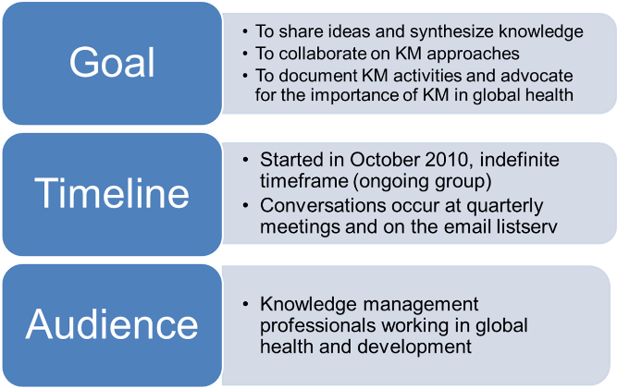
Example of a CoP: GHKC
Notes:
About
The Global Health Knowledge Collaborative, or GHKC was formed in 2010 by a group of knowledge management (KM) professionals working in global health and development. The goals of this community of practice are to:
Serve as a platform for members to share ideas, synthesize knowledge, and innovate
Collaborate on KM approaches
Collect case studies documenting experiences with KM in global health
Promote the use of KM-related products and services
Advocate for the importance of KM for organizations and projects

Slide 12
GHKC Example (continued)
Notes:
So the strategies for the Global Health Knowledge Collaborative were to:
Hold quarterly face-to-face meetings in DC and Baltimore, and in other settings when possible
Having an organizational chair that will ensure sustainability of the group and reach out to potential participants
Having an advisory committee that helps plan the meetings and determine the outcomes and direction of the group

Slide 13
Notes:
Here’s a screenshot of their website’s home page

Slide 14
Get Started: Define Your CoP

Slide 15
Get Started: Define Your CoP (continued)

Slide 16
Roles and Responsibilities
CoP Leader/Community Manager
Facilitator
Technical experts
Members
Notes:
CoP Leader/community manager: Ensure the information provided is accurate and that members are kep abreast of changes and events.
Facilitator: Brings about an outcome by providing indirect tor helpful assistance/guidance to a discussion.
Technical experts: Usually a guest to the community, but will serve as a subject matter expert by commenting on postings, responding to questions, and furthering the discussion with technical guidance.
Members: To share relevant lessons learned, best practices and experiences with other members.

Slide 17
More on CoP Leaders…
Foster learning
Stimulate interaction
Create new knowledge
Promote awareness among new members
Develop common understandings
Identify and share good methodologies, tools, projects, etc.
Build a network of experts in specific areas of interest

Slide 18
Strategies for Fostering Engagement
Recognize community members’ contributions, helping peers, sharing experiences, connecting experts, and mentoring
Create processes for rewarding knowledge nuggets captured, created, and shared
Recognize and market communities internally and externally
Organize and conduct online discussion forums
Attract new members
Enable participants to ask an expert in their field questions to which they can respond over a set period of time
Create community eNewsletters

Slide 19
Common Problems and Solutions
Problem: No participation or activity; no new documents or links posted; no new discussion threads, announcements, or news
Possible solutions:
Post new content, requesting feedback and comments to elicit new conversation
Remind people to set alerts for the site
Talk to members to find out what people are working on and ask people what they would like to see on it

Slide 20
Common Problems and Solutions
Problem: Only a few people are active
Possible solutions:
Call or email members who haven’t participated in a while; find out why they haven’t been participating. Use those conversations to elicit new content and encourage contribution.
Be sure that the people who are not contributing understand how to use the tools/platform.

Slide 21
Common Problems and Solutions
Problem: People use email instead of posting questions and discussions on the CoP
Possible solutions:
Make a public statement that no questions sent by individual email will be answered but that questions posted to the community will always be answered in set time.
Respond to all email questions and ask the requestor to post the question in the forum.
Many CoPs use an email format, such as a listserv, specifically because email is a preferred mode of communication for many.
Notes:
Email habit is a hard one to break.

Slide 22
Common Problems and Solutions
Problem: Another community is focused on the same topic
Possible solutions:
If the members of another community are current/previous members of your community, talk to them about why the community isn’t meeting their needs.
If the other community takes a specific focus, make cross-linkages to the other community’s site and refer people back and forth as needed.
If the new community consists of people who are not participating in the current community, ask some of the same questions. See if there is sufficient overlap that the new community might be better managed as a sub-CoP of the current site or a merger between the communities.
Notes:
Email habit is a hard one to break.

Slide 23
What Makes a Successful CoP?
Clear purpose – what will it be used to do?
Safe and trusted environment
Committed core group of active participants
Motivated
Knowing the needs of participants
Having a clear action plan with activities to meet needs
Blending face-to-face and online activities
Nurturing and sustaining the CoP requires effort and energy from a skilled leader.

Slide 24
More on Online Discussion Forums
The IBP Knowledge Gateway
Notes:
IBP stands for Implementing Best Practices.

Slide 25
Background on IBP Knowledge Gateway
Dynamic electronic communication tool to support virtual CoPs
Easily navigable platform
Allows for participation online or by e-mail
Can be accessed in settings with low Internet bandwidth
Used by >300,000 people worldwide
Designed specifically for health and development professionals

Slide 26
Online Discussion Forums
Key objectives:
Provide a venue for virtual collaboration among field-based practitioners and program managers
Facilitate dialogue across professions and countries
Strengthen exchange of knowledge and resource materials
Strengthen existing partnerships and encourage new ones

Slide 27
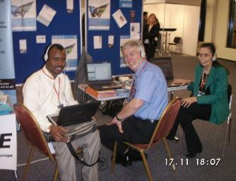
Forum Structure
Length varies (1–6 weeks)
Include daily or weekly subtopics
Include panel of subject matter experts
Often launched with a videoconference/webcast linking countries from different regions

Slide 28
Evaluation Statistics: Reach
13,827 people registered for all 26 forums
Average no. of participants=532; Median=488
Average of 64 countries represented
61% of forum postings from participants in developing countries
Average number of participant postings=109 (Median=87)

Slide 29
Evaluation Statistics: Satisfaction and Use
61% of respondents were very satisfied
68% of respondents felt there was the right amount of discussion
54% felt that forums definitely met their specific goals
75% of participants surveyed like receiving a single, digested email every day
39% of respondents reported having already used resources discussed in the forum in their work; 42% of respondents planned to do so

Slide 30
If I Build It, Will They Come?
Notes:
In January 2011, there was a discussion forum on Sustaining Active Communities of Practice for Global Health. The following slides will summarize the discussion from that forum.

Slide 31
Who Participated?
Job positions represented by contributing participants:
Lecturer/Instructor
Fundraising manager
Medical doctor
Chief nursing officer
Health and development consultant
Program manager/officer
Resource managers
Research officers
Communications & web content manager
Vice president (of a global organization)
IT consultant

Slide 32
Statistics
Facilitated by 11 experts
Attracted 302 participants
48 countries represented
87 contributions received from participants from the following countries: Canada, UK, Kenya, Switzerland, India, South Africa, Nepal, Zambia, Saint Vincent and the Grenadines, Uganda, and the United States

Slide 33
Overarching Themes
Importance of exchanging knowledge between peers and across organizations
Consensus that CoPs that reach across organizations add more value and diversity than internal CoPs
CoPs can function as a catalyst for advancing the knowledge base
People make up the fundamental part of a CoP
Moderator plays a key role in provoking discussion
Successful CoPs welcome all levels of participation
Combining face-to-face with virtual communication

Slide 34
Overarching Themes (continued)
Technology functions a double-edged sword
Technology provides the tools, but needs to meet the needs of the user and address issues of access and connectivity
Mobile-friendly platforms should be explored for cost and feasibility
Sustainability in maintaining a CoP
Current hot topics are more likely to engage members. Examples: outmigration, task shifting, new developments in a particular topic
Multilingualism: A number of Spanish-language CoPs exist
Translating documents ad hoc not perfect, but a start. Perfecting tools like Google Translate may not be that far off.

Slide 35
Lessons Learned
Establish a realistic timeline for launch, activities, etc.
Establish roles and responsibilities of all parties before launch
Choose topics that are current
Select energetic facilitator(s)
Maintain regular contact with community members
Evaluate forums and community activity and address issues

Slide 36
Summary
Build it and they will not necessarily come automatically … technology by itself will not guarantee a successful community.
The community leader (or manager) is the key to a successful and vibrant community.
It is hard work and requires lots of energy…

Slide 37
How You Can Support a CoP
Provide access to technology such as
Listservs
Online collaboration systems
Support community leaders
Facilitate community events/activities
Provide access to outside expertise, knowledge or information
Share your best practices outside the community

Slide 38
Take-Aways
Plan in advance
Have clear goals, a purpose, and a strategy for engaging your audience
Ask the right questions, know your members
Have a dedicated manager
Use tools like discussion forums, polls, webinars, newsletters, etc. to keep members engaged
Incorporate face-to-face events when possible

Slide 39
Thank you!
For additional information on CoPs, please take our eLearning course:
https://www.globalhealthlearning.org/course/online-communities-practice-cops-global-health

